Slide 1
SSL:
Secure Socket Layer
By: Subhankar Rahaman

Slide 2
Overview
Definition
History & Background
SSL Assurances
SSL Session
Problems
Attacks & Defenses

Slide 3
Definition
SSL: Short for Secure Sockets Layer, a protocol developed by Netscape for transmitting private documents via the Internet.

Slide 4
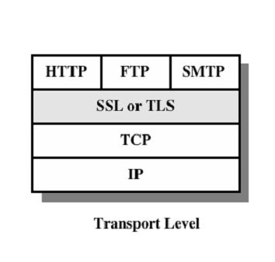
History & Background
SSL uses a private key to encrypt data that's transferred over the SSL connection (Public Key Encryption)
Works at the Transport Level (OSI layer 4)

Slide 5

History & Background
Many e-commerce websites use the protocol to obtain confidential user information, such as credit card numbers.
Embedded in Netscape Navigator and Internet Explorer
URLs that require an SSL connection start with https: instead of http:.

Slide 6



SSL Assurances
Confidentiality
Authentication
Integrity
No Non-repudiation

Slide 7
SSL Session (4 steps)
Negotiation of Cryptographic Parameters
    Unencrypted messages sent to establish parameters to use for communication (algorithm, version, etc)
Key Agreement
    Generation of Secret key
Authentication
    Client authenticates to the server
Confidentiality and Integrity
    Secret keys used to exchange private messages with integrity assurance

Slide 8
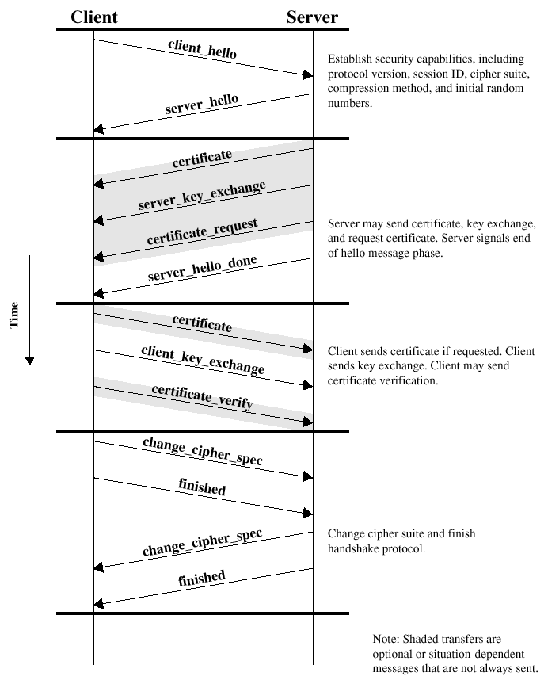

Slide 9
Problems
Short Key Length
  Keys can be brute-forced
    40bit keys have been cracked in < 1 day
SSL relies on Web browsers have a pre-installed list of top level Certificate Authorities
  current browsers have no built-in mechanism for certificate revocation
Lesson: Just because you see the lock, does not mean you are secure

Slide 10
Attacks & Defenses
Man-In-The-Middle Attack
  Someone intercepts your message en-route and masquerades as the party you are trying to connect to.
Solution:
  Only accept certificates from known & valid CA’s.
  (Check this by clicking on the lock & verifying the CA’s site.)

Slide 11
Attacks & Defenses
Cipher Suite Rollback Attack
  During negotiation of cryptographic parameters (done unencrypted), an attacker can modify the communication to suggest using an older (weaker) suite (SSL v2)
  This older suite, can then be attacked much easier
Solution:
  Do not allow SSL to communicate with older versions (modify browser setting)

Slide 12
Attacks & Defenses
Timing Attacks
  can extract private keys from an OpenSSL-based web server running on a machine in the local network
Solution:
  Use newer crypto libraries that incorporate blinding

Slide 13
THANK YOU

